Slide 1
Wireless Communications
Advanced Topics in Wireless

Slide 2


Future Wireless Networks
Ubiquitous Communication Among People and Devices
Next-Gen Cellular/WiFi
Smart Homes/Spaces
Autonomous Cars
Smart Cities
Body-Area Networks
Internet of Things
All this and more …

Slide 3
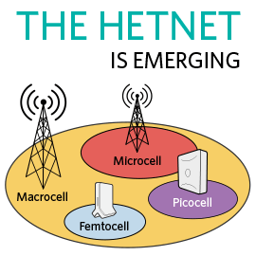



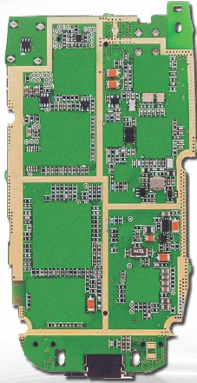
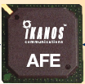
Challenges
5G
AdHoc
Network Challenges
High performance
Extreme energy efficiency
Scarce/bifurcated spectrum
Heterogeneous networks
Reliability and coverage
Seamless internetwork handoff
Device/SoC Challenges
Performance
Complexity
Size, Power, Cost
High frequencies/mmWave
Multiple Antennas
Multiradio Integration
Coexistance
Short-Range
BT
Radio
Cellular
GPS
Cog
Mem
WiFi
CPU
mmW

Slide 4

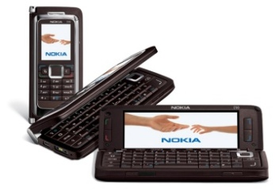

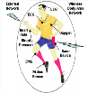
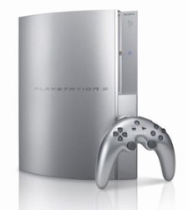
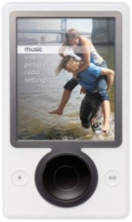
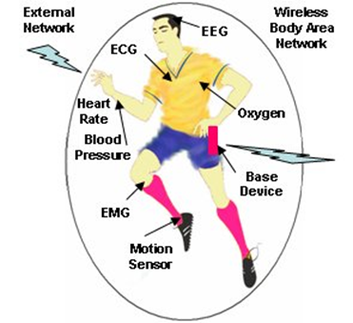

Future Cell Phones
Everything wireless in one device
Burden for this performance is on the backbone network
San Francisco
BS
BS
LTE backbone is the Internet
Internet
Boston
N^{th}-Gen
Cellular
Phone
System
N^{th}-Gen
Cellular
BS
Much better performance and reliability than today
- Gbps rates, low latency/energy , 99.999% coverage

Slide 5
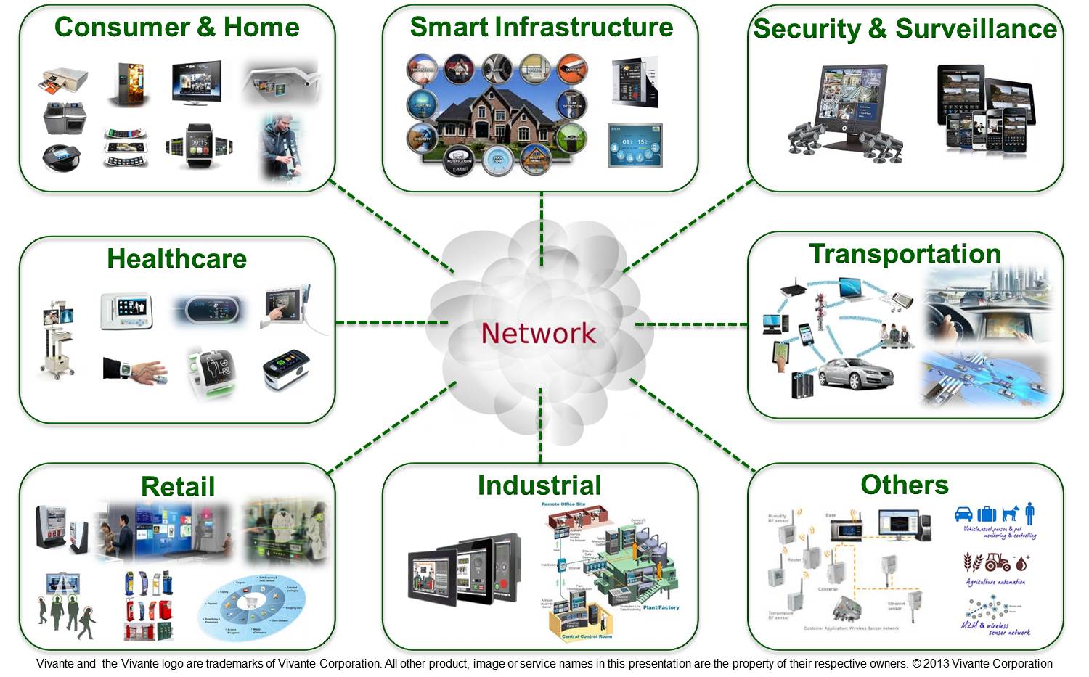
What is the Internet of Things:
Enabling every electronic device to be connected to each other and the Internet
Includes smartphones, consumer electronics, cars, lights, clothes, sensors, medical devices,…
Value in IoT is data processing in the cloud
Different requirements than smartphones: low rates/energy consumption

Slide 6
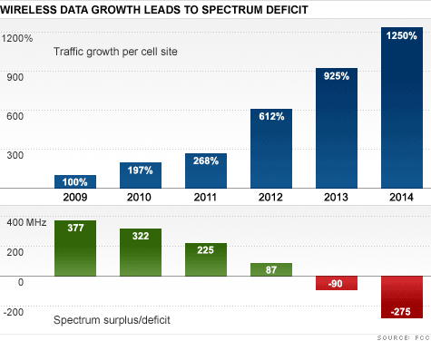



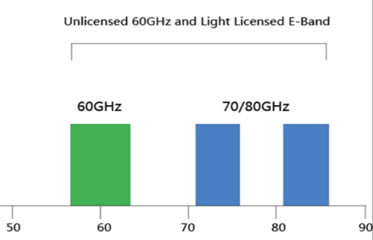
The Licensed Airwaves are “Full”
Also have Wifi
Exponential Growth in Data Demand
Leading to massive spectrum deficit
And mmWave
⬅10s of GHz of Spectrum➔
Source: FCC
Notes:
Spectrum Deficit =>
Small Cells for Cellular Capacity enhancement
WiFi Data Offload to complement available Cellular Spectrum

Slide 7
Enablers for increasing wireless data rates
More spectrum (mmWave)
(Massive) MIMO
Innovations in cellular system design
Software-defined wireless networking

Slide 8
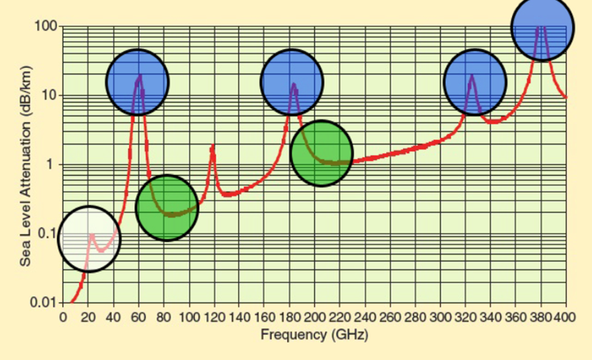
mmW as the next spectral frontier
Large bandwidth allocations, far beyond the 20MHz of 4G
Rain and atmosphere absorption not a big issue in small cells
Not that high at some frequencies; can be overcome with MIMO
Need cost-effective mmWave CMOS; products now available
Challenges: Range, cost, channel estimation, large arrays

Slide 9

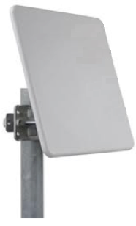
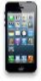
What is Massive MIMO?
Dozens of devices
Hundreds of
BS antennas
A very large antenna array at each base station
An order of magnitude more antenna elements than in conventional systems
A large number of users are served simultaneously
An excess of base station (BS) antennas
Essentially multiuser MIMO with lots of base station antennas
T. L. Marzetta, “Noncooperative cellular wireless with unlimited numbers of base station
antennas,” IEEE Trans. Wireless Commun., vol. 9, no. 11, pp. 3590–3600, Nov. 2010.

Slide 10



mmWave Massive MIMO
⬅10s of GHz of Spectrum➔
Dozens of devices
Hundreds
of antennas
mmWaves have large attenuation and path loss
For asymptotically large arrays with channel state information, no attenuation, fading, interference or noise
mmWave antennas are small: perfect for massive MIMO
Bottlenecks: channel estimation and system complexity
Non-coherent design holds significant promise

Slide 11
Non-coherent massive MIMO
Propose simple energy-based modulation
No capacity loss for large arrays:
Holds for single/multiple users (1 TX antenna, n RX antennas)
Constellation optimization: unequal spacing

Slide 12
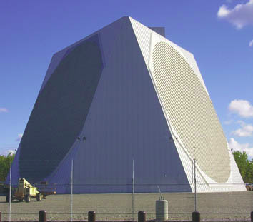
Need 50-100 antennas for an SER of 10⁻⁴ Depending on data rate requirements
Minimum Distance Design criterion: Significantly worse performance than the new designs.
Design robust to channel uncertainty
Noncoherent communication demonstrates promising performance with reasonably-sized arrays

Slide 13
Rethinking Cellular System Design
Cooperating
Transmitters
How should cellular
systems be designed?
Small
Cell
Massive
MIMO
Relay
Dynamic
Access
Will gains be big or
incremental; in capacity,
coverage or energy?
Distributed
Antennas
Traditional cellular design assumes system is “interference-limited”
No longer the case with recent technology advances:
MIMO, multiuser detection, cooperating BSs (CoMP) and relays
Raises interesting questions such as “what is a cell?”
Energy efficiency via distributed antennas, small cells, MIMO, and relays
Dynamic self-organization (SoN) needed for deployment and optimization

Slide 14

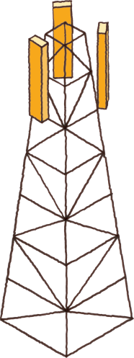

Small cells are the solution to increasing cellular system capacity
In theory, provide exponential capacity gain
SoN Server
Future cellular networks will be hierarchical
Large cells for coverage
Small cells for capacity and power efficiency
Small cells require self-optimization in the cloud
IP Network
X2
X2
SW
Agent
Small Cell Challenges
SoN algorithmic complexity
Distributed vs centralized control
Backhaul and site acquisition
X2
X2
Small cell BS
Macrocell BS

Slide 15


WiFi is the small cell of today
Primary access mode in residences, offices, and
wherever you can get a WiFi signal
Lots of spectrum, excellent PHY design
The Big Problem with WiFi
The WiFi standard lacks good mechanisms to mitigate interference in dense AP deployments
Static channel assignment, power levels, and carrier sense thresholds
In such deployments WiFi systems exhibit poor spectrum reuse and significant contention among APs and clients
Result is low throughput and a poor user experience

Slide 16

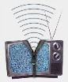
Why not use SoN for WiFi?
all wireless networks?
Vehicle networks
SoN
Server
mmWave networks
TV White Space &
Cognitive Radio

Slide 17
Software-Defined Network Architecture (generalization of NFV, SDN, cloud-RAN, and distributed cloud)
App layer
Cloud Computing
Video
Security
Vehicular
Networks
M2M
Health
Freq.
Allocation
Power
Control
Self
Healing
ICIC
QoS
Opt.
CS
Threshold
Network Optimization
UNIFIED CONTROL PLANE
HW layer
Distributed Antennas
WiFi
Cellular
mmWave
…
Ad-Hoc
Networks

Slide 18
SDWN Challenges
Algorithmic complexity
Frequency allocation alone is NP hard
Also have MIMO, power control, CST, hierarchical networks: NP-really-hard
Advanced optimization tools needed, including a combination of centralized (cloud) distributed, and locally centralized (fog) control
Hardware Interfaces
Seamless handoff
Resource pooling
Cloud Optimization
Fog
Optimization
X2
X2
X2
X2
Small cell BS
Macrocell BS

Slide 19
New PHY and MAC Techniques
New Waveforms
Robust to rapidly changing channels (OTFS)
More flexible and efficient subcarrier allocation (variants of OFDM)
Coding
Incremental research (polar vs. LDPC), no new breakthroughs
Access
Efficient access for low-rate IoT Devices (sparse code MAC, GFDM, OTFS, variants of OFDMA)
Access/interference mitigation for unlicensed LTE

Slide 20
Ad-Hoc Networks
Peer-to-peer communications
No backbone infrastructure or centralized control
Routing can be multihop.
Topology is dynamic.
Fully connected with different link SINRs
Open questions
Fundamental capacity region
Resource allocation (power, rate, spectrum, etc.)
Routing
Notes:
-No backbone: nodes must self-configure into a network.
-In principle all nodes can communicate with all other nodes, but multihop routing can reduce the interference associated with direct transmission.
-Topology dynamic since nodes move around and link characteristics change.
-Applications: appliances and entertainment units in the home, community networks that bypass the Internet. Military networks for robust flexible easily-deployed network (every soldier is a node).

Slide 21
Cooperation in Wireless Networks
Many possible cooperation strategies:
Virtual MIMO, relaying (DF, CF, AF), one-shot/iterative conferencing, and network coding
Nodes can use orthogonal or non-orthogonal channels.
Many practice and theoretical challenges
New full duplex relays can be exploited

Slide 22
General Relay Strategies
TX1
RX1
X₁
Y₄=X₁+X₂+X₃+Z₄
relay
Y₃=X₁+X₂+Z₃
X₃= f(Y₃)
Y₅=X₁+X₂+X₃+Z₅
X₂
TX2
RX2
Can forward message and/or interference
Relay can forward all or part of the messages
Much room for innovation
Relay can forward interference
To help subtract it out

Slide 23
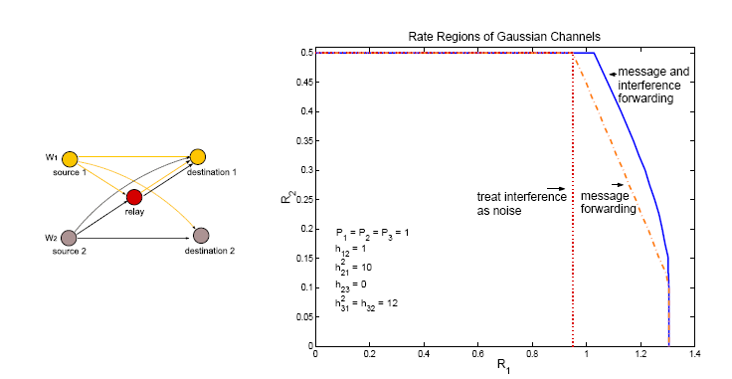
Beneficial to forward both interference and message
For large powers, this strategy approaches capacity

Slide 24
Spectrum innovations beyond licensed/unlicensed paradigms

Slide 25
Cognitive Radio Paradigms
Underlay
Cognitive radios constrained to cause minimal interference to noncognitive radios
Interweave
Cognitive radios find and exploit spectral holes to avoid interfering with noncognitive radios
Overlay
Cognitive radios overhear and enhance noncognitive radio transmissions
Knowledge
and
Complexity

Slide 26
Underlay Systems
Cognitive radios determine the interference their transmission causes to noncognitive nodes
Transmit if interference below a given threshold
The interference constraint may be met
Via wideband signalling to maintain interference below the noise floor (spread spectrum or UWB)
Via multiple antennas and beamforming
I_{P}
NCR
NCR
CR
CR

Slide 27
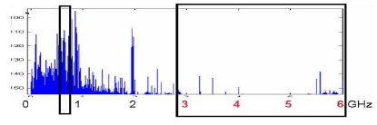
Interweave Systems
Measurements indicate that even crowded spectrum is not used across all time, space, and frequencies
Original motivation for “cognitive” radios (Mitola’00)
These holes can be used for communication
Interweave CRs periodically monitor spectrum for holes
Hole location must be agreed upon between TX and RX
Hole is then used for opportunistic communication with minimal interference to noncognitive users

Slide 28
Overlay Systems
Cognitive user has knowledge of other user’s message and/or encoding strategy
Used to help noncognitive transmission
Used to presubtract noncognitive interference
CR
RX1
RX2
NCR

Slide 29
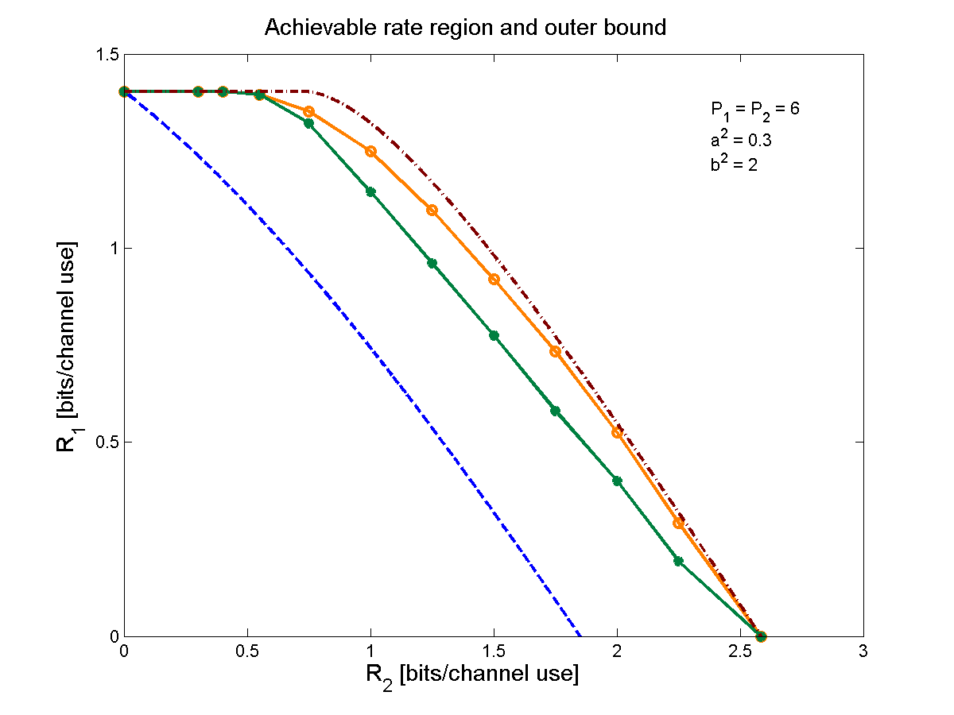
Performance Gains from Cognitive Encoding
outer bound
our scheme
prior schemes
Only the CR
transmits

Slide 30
“Green” Wireless Networks
Pico/Femto
How should wireless
systems be redesigned
for minimum energy?
Coop
MIMO
Relay
Research indicates that
significant savings is possible
DAS
Drastic energy reduction needed (especially for IoT)
New Infrastuctures: Cell Size, BS/AP placement, Distributed Antennas (DAS), Massive MIMO, Relays
New Protocols: Coop MIMO, RRM, Sleeping, Relaying
Low-Power (Green) Radios: Radio Architectures, Modulation, Coding, Massive MIMO

Slide 31
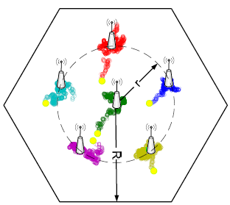
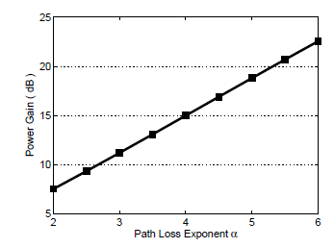
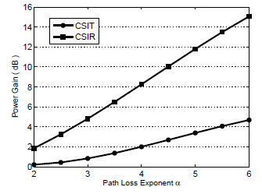
DAS to minimize energy
Optimize distributed BS antenna location
Primal/dual optimization framework
Convex; standard solutions apply
For 4+ ports, one moves to the center
Up to 23 dB power gain in downlink
Gain higher when CSIT not available
6 Ports
3 Ports

Slide 32
Energy-Constrained Radios
Transmit energy minimized by sending bits very slowly
Leads to increased circuit energy consumption
Short-range networks must consider both transmit and processing/circuit energy.
Sophisticated encoding/decoding not always energy-efficient.
MIMO techniques not necessarily energy-efficient
Long transmission times not necessarily optimal
Multihop routing not necessarily optimal
Sub-Nyquist Sampling
Notes:
All the sophisticated high-performance communication techniques developed since WW2 may need to be thrown out the window.
By cooperating, nodes can save energy

Slide 33

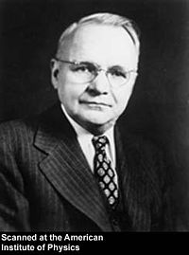
Sub-Nyquist Sampled Channels
Analog Channel
Message
Encoder
Decoder
Message
Wideband systems may preclude Nyquist-rate sampling!
C. Shannon
Sub-Nyquist sampling well explored in signal processing
Landau-rate sampling, compressed sensing, etc.
Performance metric: MSE
H. Nyquist
We ask: what is the capacity-achieving sub-Nyquist sampler and communication design

Slide 34
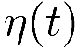
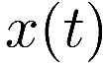
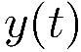
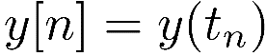
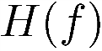

Capacity and Sub-Nyquist Sampling
Consider linear time-invariant sub-sampled channels
Preprocessor
Theorem: Capacity-achieving sampler
zzzzzzzzzz
zzzzzzzzzz
or
Optimal filters suppress aliasing
Sub-Nyquist sampling is optimal for some channels!

Slide 35
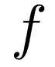
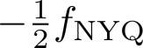
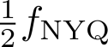
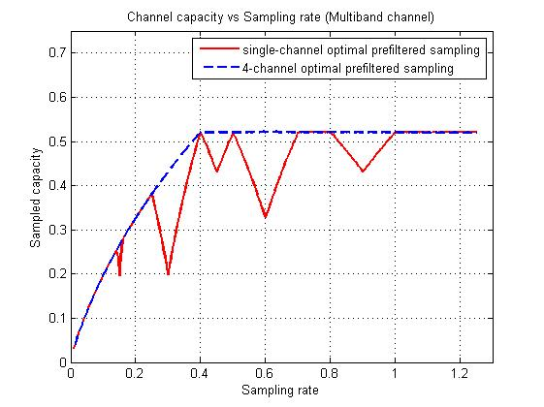
Example: Multiband Channel
Consider a “sparse” channel, and an optimally designed 4-branch filter bank sampler
Outperforms single-branch sampling.
Achieves full-capacity above Landau Rate
Landau Rate: sum of total bandwidths

Slide 36
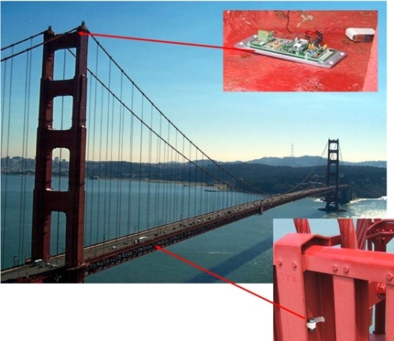
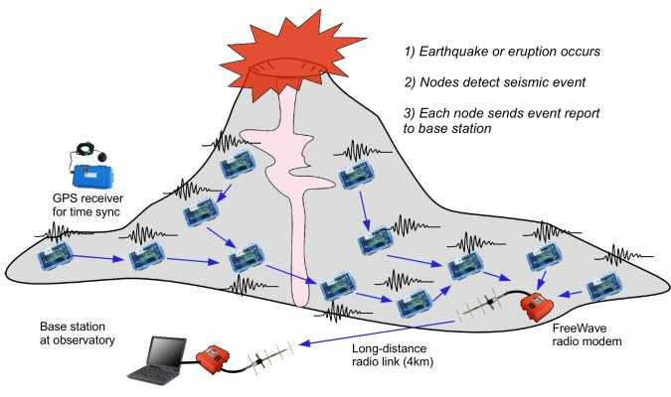
Wireless Sensor Networks
Data Collection and Distributed Control
Smart homes/buildings
Smart structures
Search and rescue
Homeland security
Event detection
Battlefield surveillance
Energy (transmit and processing) is the driving constraint
Data flows to centralized location (joint compression)
Low per-node rates but tens to thousands of nodes
Intelligence is in the network rather than in the devices

Slide 37

Where should energy come from?
Batteries and traditional charging mechanisms
Well-understood devices and systems
Wireless-power transfer
Poorly understood, especially at large distances and with high efficiency
Communication with Energy Harvesting Devices
Intermittent and random energy arrivals
Communication becomes energy-dependent
Can combine information and energy transmission
New principals for communication system design needed.

Slide 38

Distributed Control over Wireless
Automated Vehicles
- Cars
- Airplanes/UAVs
- Insect flyers
Interdisciplinary design approach
Control requires fast, accurate, and reliable feedback.
Wireless networks introduce delay and loss
Need reliable networks and robust controllers
Mostly open problems
: Many design challenges

Slide 39
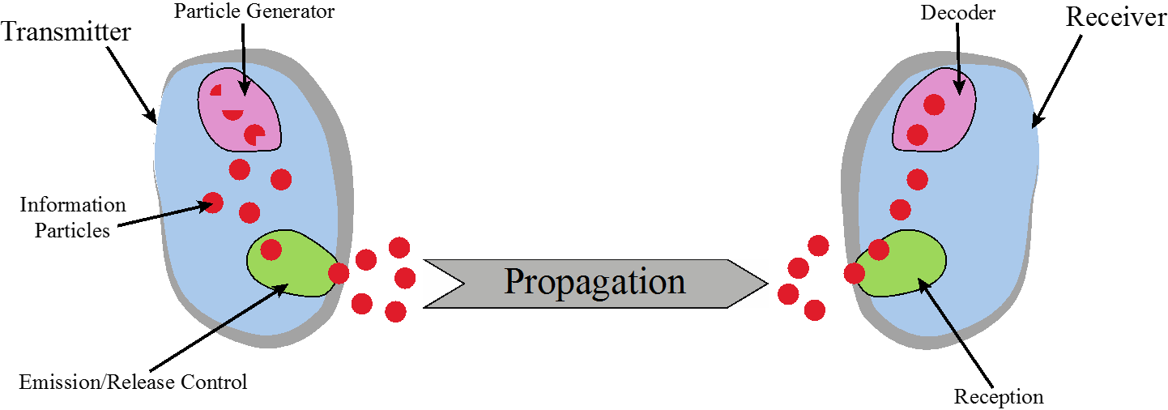
Chemical Communications
Can be developed for both macro (>cm) and micro (<mm) scale communications
Greenfield area of research:
Need new modulation schemes, channel impairment mitigation, multiple acces, etc.

Slide 40
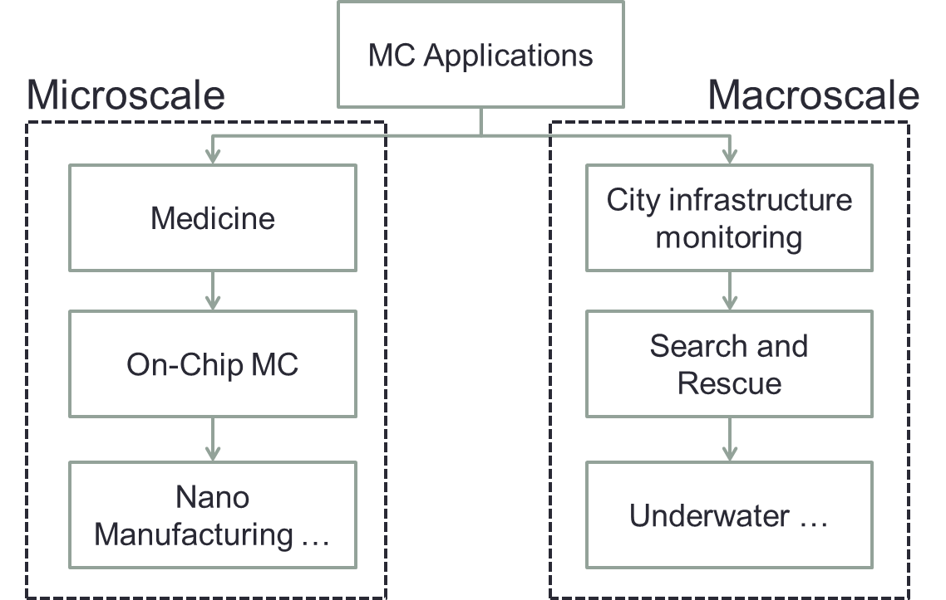

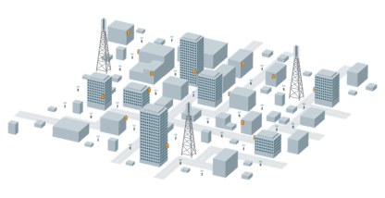

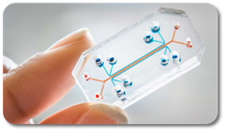
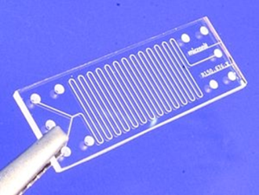


Applications
Data rate: .5 bps
“fan-enhanced” channel

Slide 41
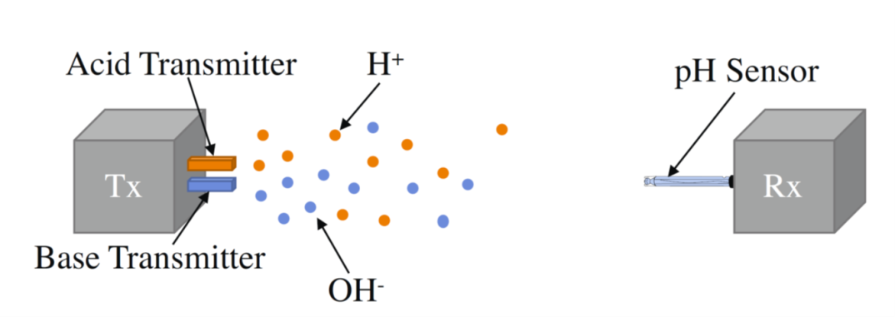
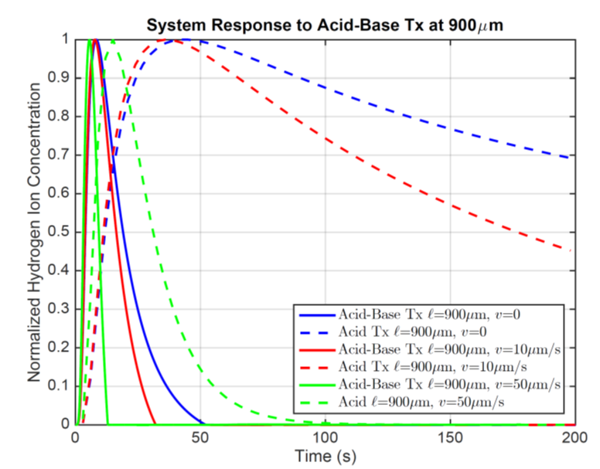
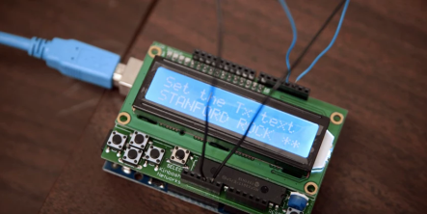
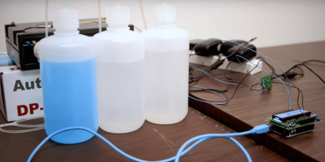
Current Work
Slow dissipation of chemicals leads to ISI
Can use acid/base transmission to decrease ISI
Similar ideas can be applied for multilevel modulation and multiuser techniques
Currently testing in our lab
New equalization based on machine learning
Increased data rate 10x
Sending text messages with windex and vinegar
Stanford Report:
November 15, 2016

Slide 42

The brain as a network

Slide 43
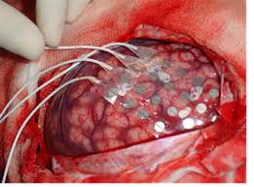
Epileptic Seizure Focal Points
Seizure caused by an oscillating signal moving across neurons
When enough neurons oscillate, a seizure occurs
Treatment “cuts out” signal origin: errors have serious implications
Directed mutual information spanning tree algorithm applied to ECoG measurements estimates the focal point of the seizure
Application of our algorithm to existing data sets on 3 patients matched well with their medical records
ECoG
Data

Slide 44
Summary
The next wave in wireless technology is upon us
This technology will enable new applications that will change people’s lives worldwide
Future wireless networks must support high rates for some users and extreme energy efficiency for others
Small cells, mmWave massive MIMO, Software-Defined Wireless Networks, and energy-efficient design key enablers.
Communication tools and modeling techniques may provide breakthroughs in other areas of science

